Slide 1
AH[3D]MED
Alicia Ng, Ruchi Asthana

Slide 2
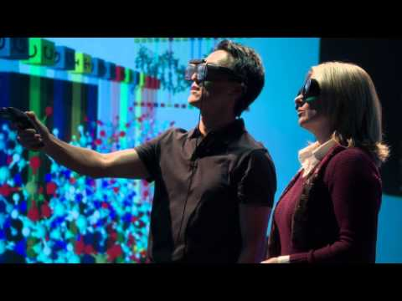
Future of Medicine
-Thorough
-Efficient
-Independent
-Convenient

Slide 3
Goal
Expand on this idea of Fast Medicine
Work with devices like Jawbone’s UP24
Connect Python → world

Slide 4
Why 3-D?
-Can identify differences not visible to naked eye
-Projects more variables thus showing more trends
-Have the potential to serve as an interactive tool

Slide 5
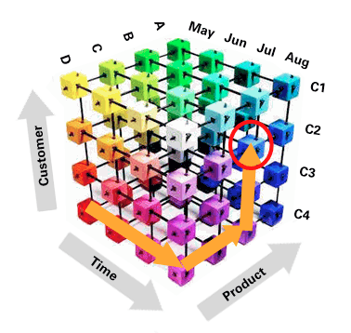
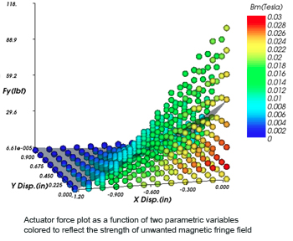
Future
Multiple Analyses (eg. sleep patterns, BMI)
Create representations beyond 3 dimension!

